Slide 1
Predicting Car Accident Severity in US
Amirtha Rajan PKS
Oct 2020

Slide 2

PROBLEM
Now more than 38,000 people die every year in crashes on U.S. roadways.
The reason for crash are limitless and hard to Predict especially on human behaviour for speeding/alcohol drive.
This affects the drivers and others on roads which concerns the government and emergency team to help them on time for rescue.

Slide 3

SOLUTION
With Machine Learning Algorithms we can train a model with datasets to predict accident severity at locations with good accuracy score depending on different attributes like weather, roads condition… etc.

Slide 4

DATA ACQUISITION AND CLEANING
US Accident Severity Dataset is acquired from Kaggle.
In total of 3.5 million records with 49 features.
Features that had no correlation were dropped.
Cleaned feature with missing values.
Converted few data to categorical feature column.

Slide 5

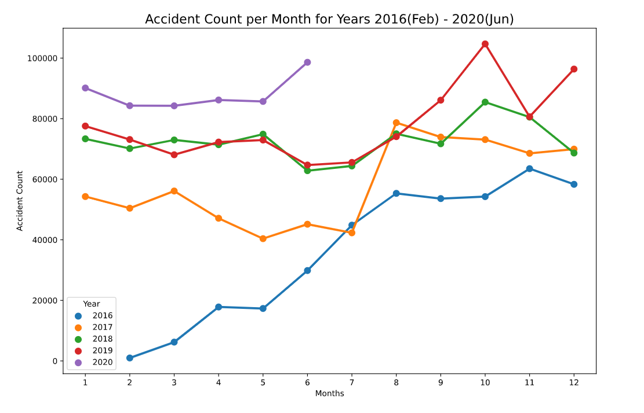
ACCIDENT COUNT HISTORY
Year :
Data has been collected from the period 2016 (Feb) to 2020(Jun)
At 2016 the accident count has drastically increased over the time.
2018 has levelled accident count.
For the current year the accident count has started with much higher rate compared to the previous years.

Slide 6
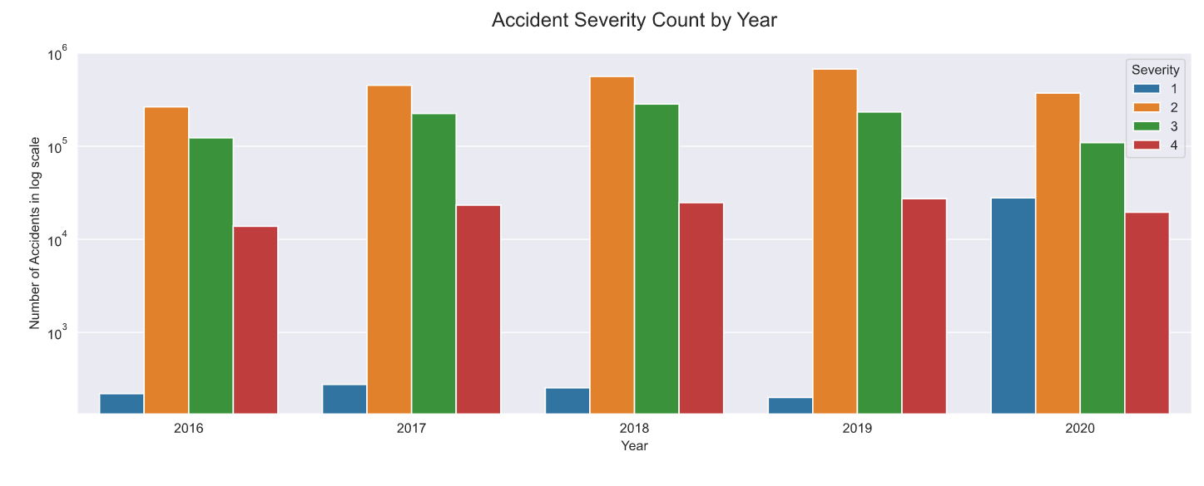
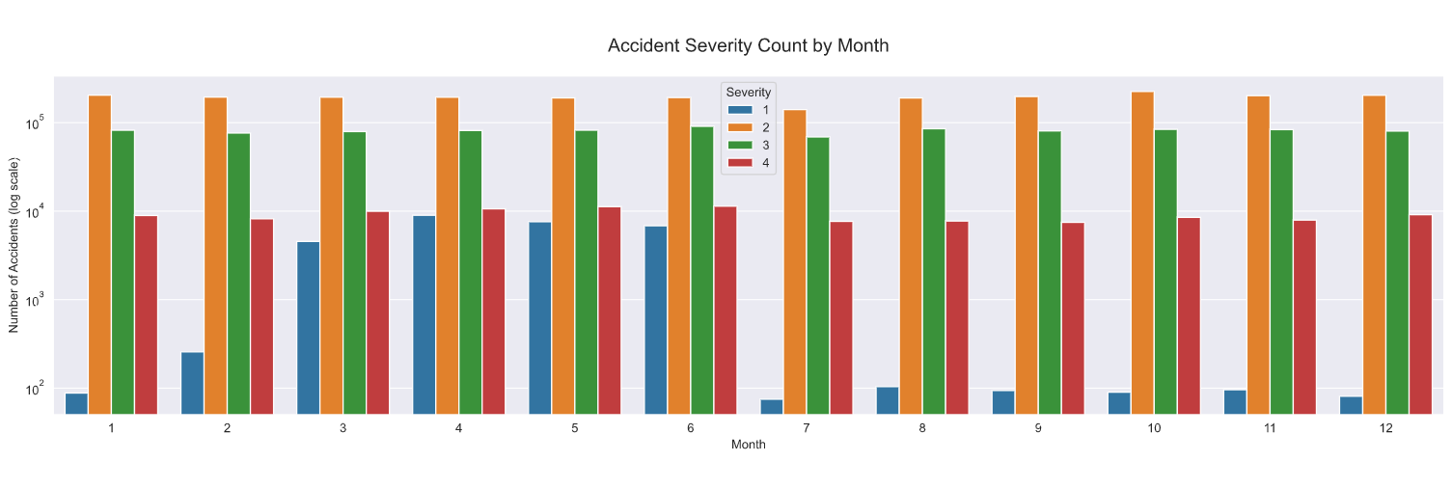
Accident Severity Counts
(Year & Month)
Most Common accidents are of severity 2.
Severity 1 (minor accidents) varies and is often hard to predict.
Accidents with Severity 3 are more compared to level 1 and 4
Severity 4 accidents are counted as casualties.

Slide 7
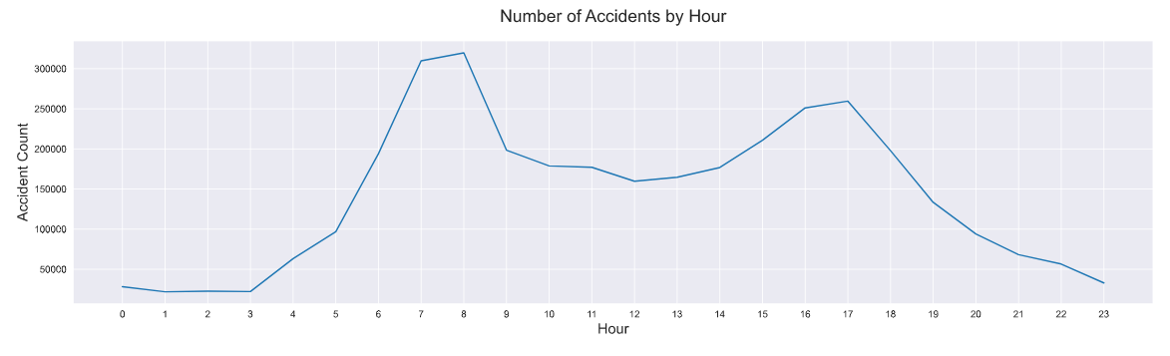
ACCIDENTS BY HOUR
Probability of accidents are more at day time with higher counts around 07:00-08:00 as it’s the peak hours people travel for work.

Slide 8
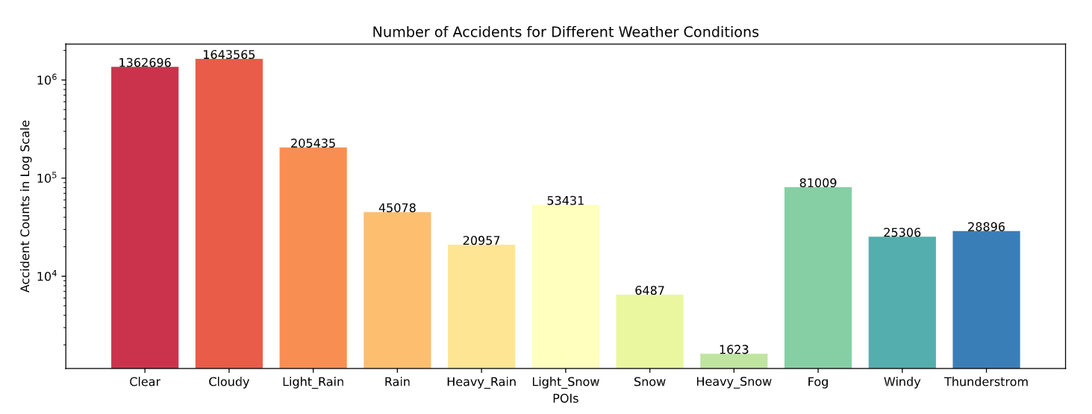
ACCIDENTS BASED ON WEATHER FORECAST
Accidents that are depend on weather exclude Clear and Cloudy conditions.
As of Rainy days people needs to be more cautious and drive slow on fog conditions as visibility distance will not be far enough to have control of.

Slide 9
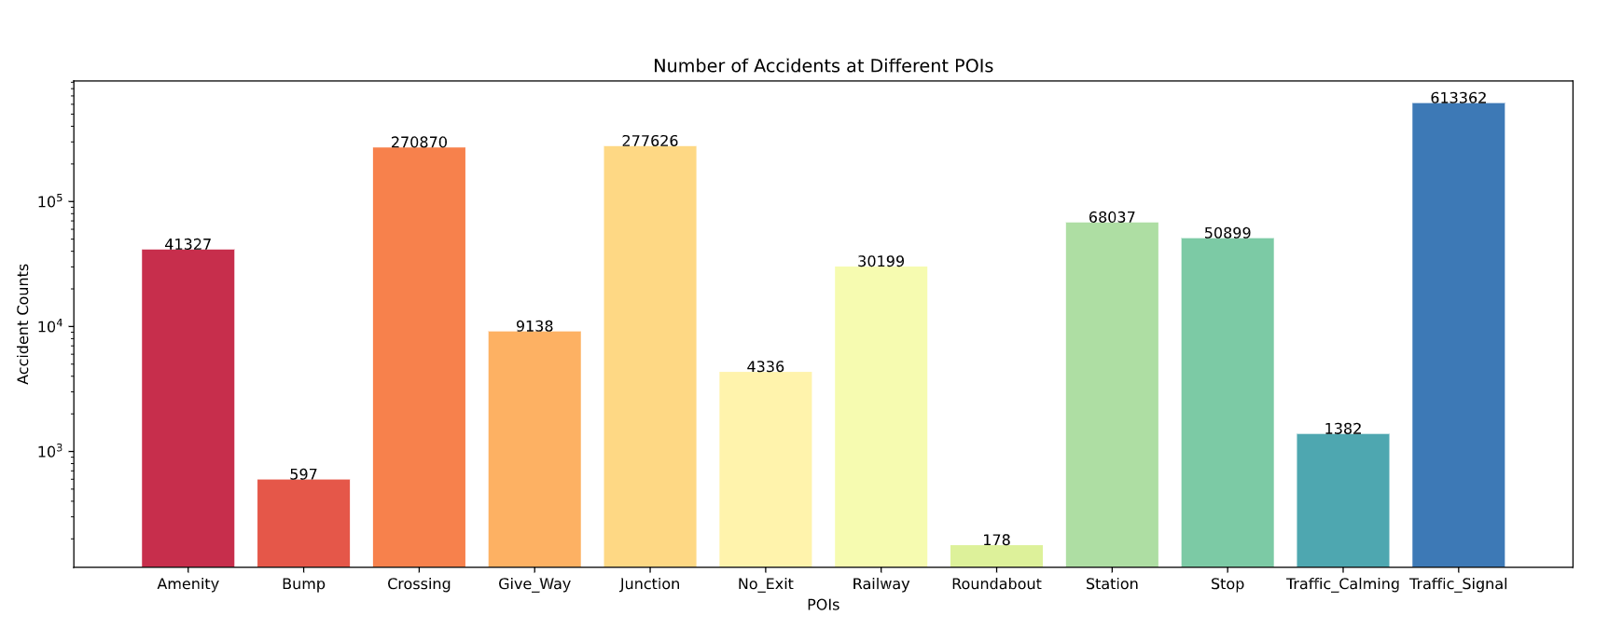
ACCIDENTS IN POIs
Accidents seems more common in traffic signals which implies most drivers did not obey the signal rules.

Slide 10
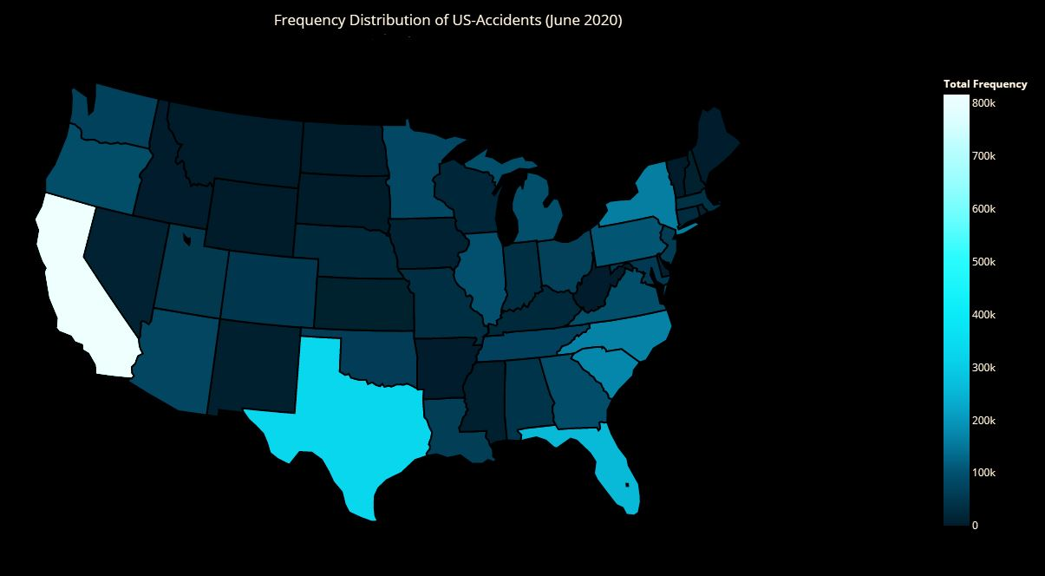

Slide 11
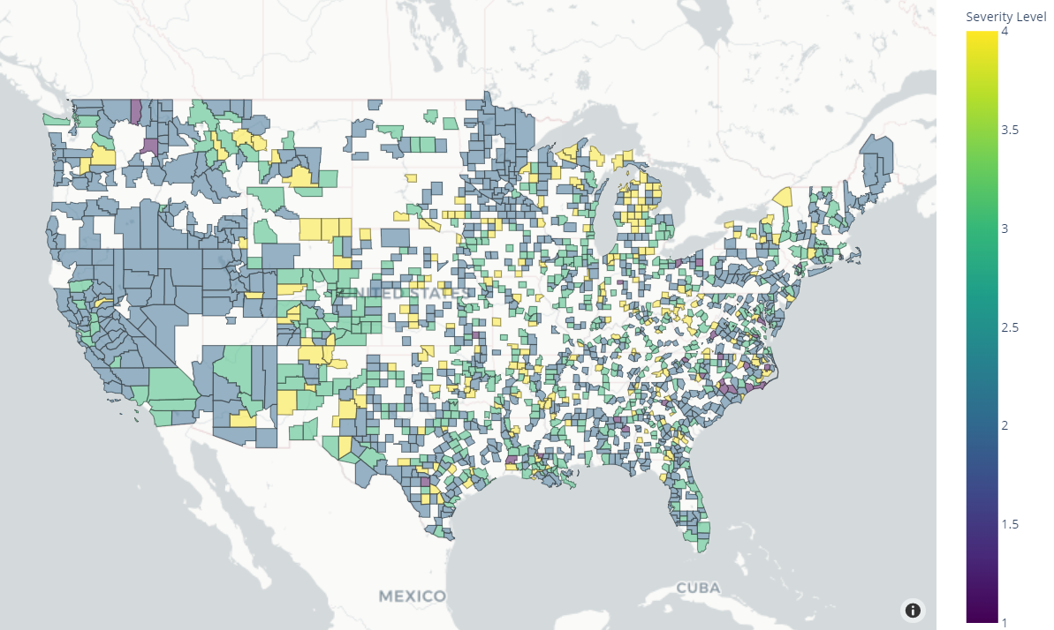
Accident Severity in Counties

Slide 12
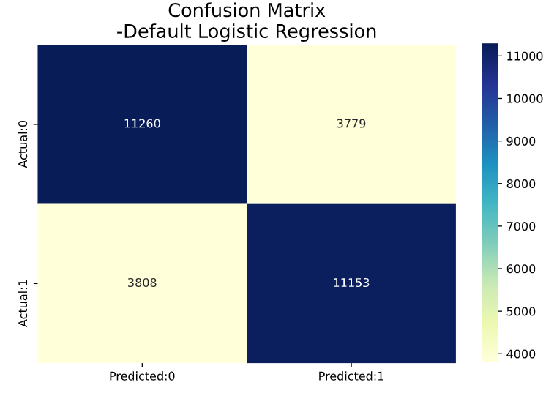
LOGISTIC REGRESSION
Results :
Train Accuracy: 74.4%
Test Accuracy: 74.7%
Build GridSearchCV for params
C : 0.001
max_iter: 100
penalty : 'none‘
Result with best params
Train Accuracy: 74.4%
Test Accuracy: 74.7%

Slide 13
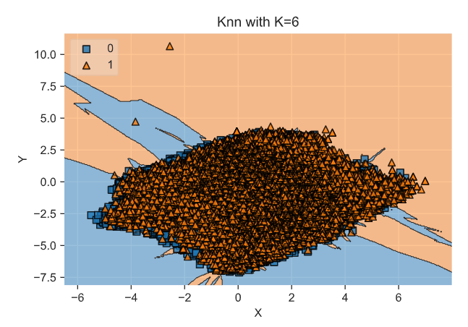
KNN CLASSIFIER
Results :
Knn score: 0.738
Accuracy score: 0.738

Slide 14
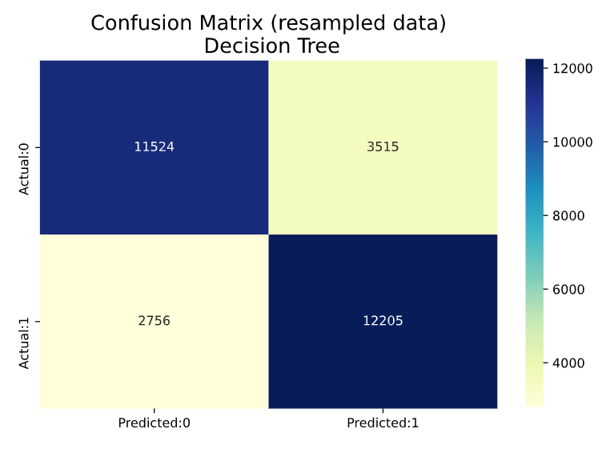
DECISION TREE CLASSIFIER
Decision Tree Classifier was built with params
max_features: None
min_samples_split: 5
Results :
Train Accuracy: 98.2%
Test Accuracy: 79.1%

Slide 15
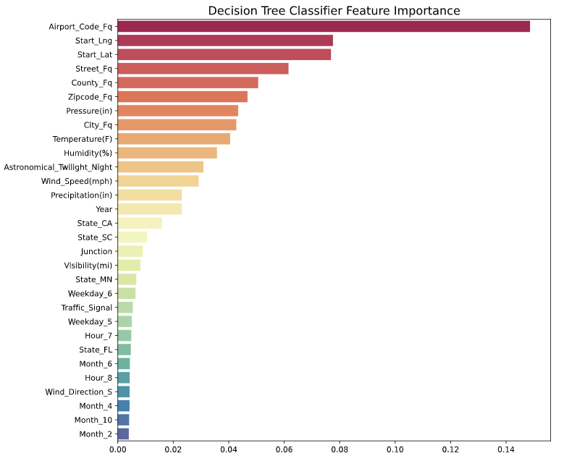
DECISION TREE CLASSIFIER Cont…
Airport frequency is far more important than any other feature.
In addition to these spatial-temporal features, weather features like pressure, temperature, humidity, and wind speed are also very important.

Slide 16
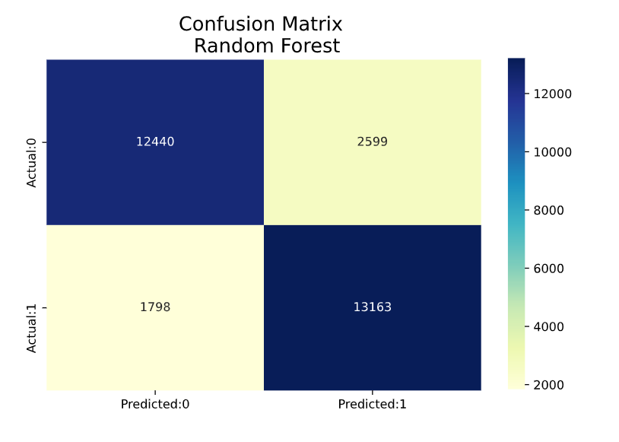
RANDOM FOREST CLASSIFIER
By using random forest classifier, the model achieved 100.0% train accuracy and 85.3% test accuracy, which is even better than the results of decision tree classifier.

Slide 17
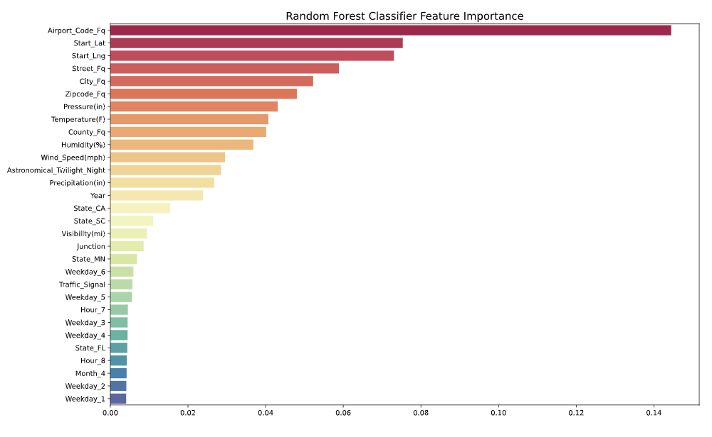
RANDOM FOREST CLASSIFIER Cont…
The important features of random forest model are almost as same as decision tree model.

Slide 18
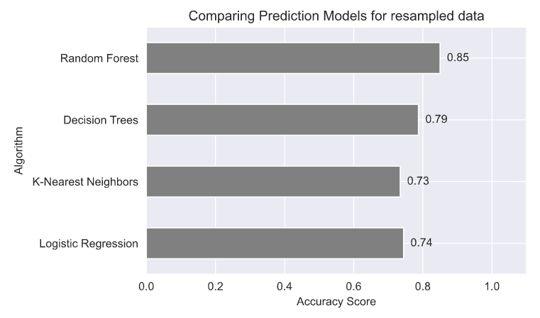
CONCLUSION
The Random Forest Classifier model performs better than other models to predict the accident.
But the accuracy of the model needs further improvement.
Need to capture more data in Severity level 4.

